Slide 1
BASIC ELECTRONICS
(24B11EC111)
Unit-1
Lecture-10
(Norton’s Theorem)

Slide 2
CONTENTS
Norton Theorem
Examples
Practice Problem
References

Slide 3
Norton Theorem
Norton’s Theorem states that a linear two terminal network can be replaced by a current source shunted by a resistance R.
In the Norton circuit, the current source is the short circuit current of the network, that is the current obtained by shorting the output of the network.
The resistance is the resistance seen looking into the network with all sources deactivated. This is the same as R_{TH}.

Slide 4
Norton Equivalent Circuit

Slide 5
From source transformations:
If we have the Thevenin equivalent circuit of a network, we can obtain the Norton equivalent by using source transformation.

Slide 6
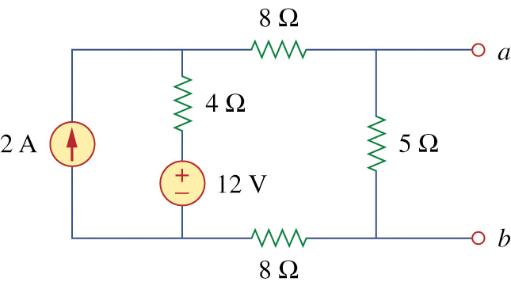
Example
Find the Norton equivalent circuit of the circuit

Slide 7
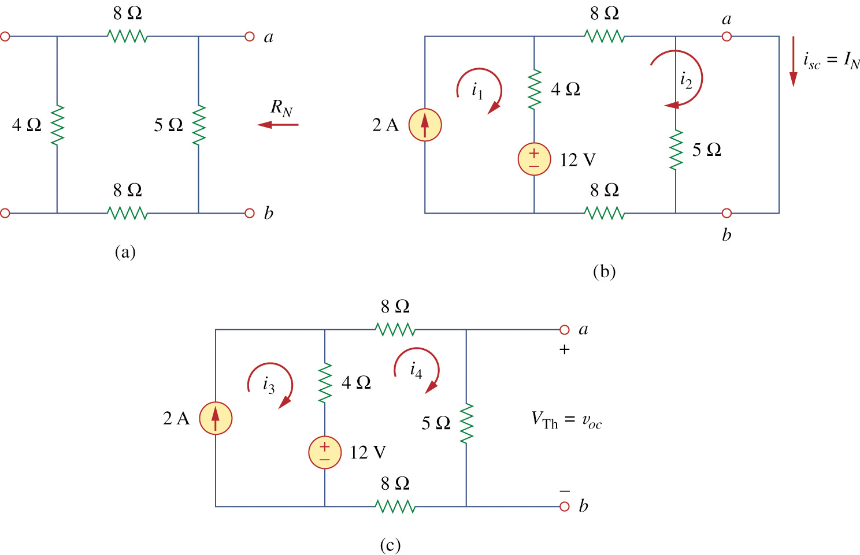

Slide 9
Alternative Method

Slide 10
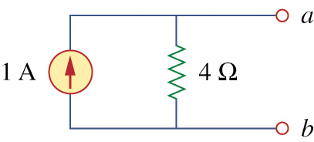

Slide 11
Example
For the circuit shown below, find the Norton equivalent circuit to the left of terminals A-B.

Slide 14
From the mesh on the left we have;

Slide 15
Therefore;
The Norton equivalent circuit is shown below.

Slide 16
Practice Problem
Find the Norton equivalent circuit to the left of terminals A-B for the network shown below. Connect the Norton equivalent circuit to the load and find the current in the 50 Ω resistor.

Slide 18
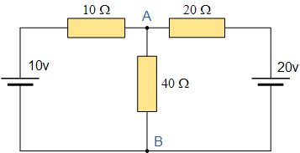
Example
Find norton equivalent circuit of Fig shown Below.
Also find current flowing through 40 ohm resistor.

Slide 19
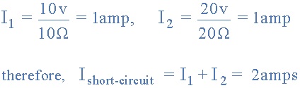
Isc :

Slide 20
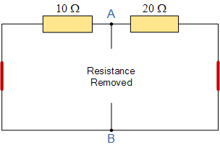


Slide 21
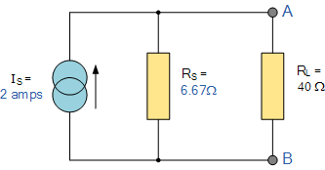


Slide 22
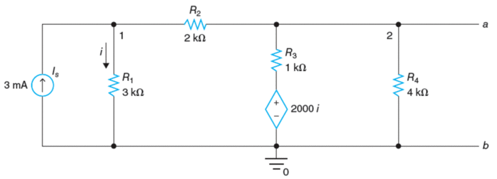
Example
Find norton equivalent circuit:

Slide 23
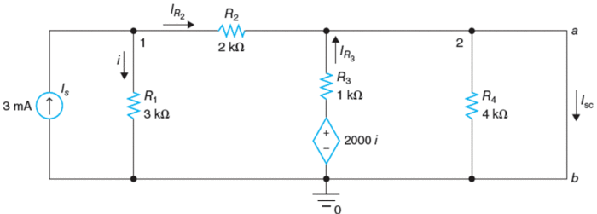
In order to determine the short-circuit current, we’ll short-circuit terminals a and b as shown in the following figure and V₂ = 0.

Slide 24
Example continued
Applying KCL at node 1 :
̶ 0.003 + V₁/3000 + V₁/2000 = 0
V₁ = 3.6 V
i = V₁/3000 = 3.6 V/3000Ω= 0.0012 A

Slide 25
Example continued
CCVS = 2000i = 2.4 V i = 0.0012 A
I_{R2} = V₁/R₂ = 1.8mA
I_{R3} = CCVS/R₃ = 2.4mA

Slide 26
I_{N} = I_{R2}+ I_{R3} = 1.8 mA + 2.4 mA = 4.2 mA

Slide 27
In order to determine R_{N}, deactivate the current source, a test voltage of 1 V is applied across terminals a and b as shown in the following figure.
V_{t} = 1 V.

Slide 28
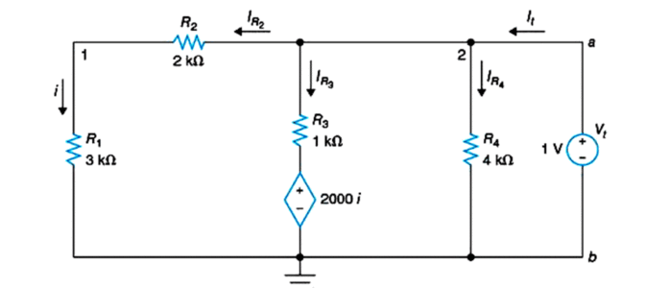
I_{R2} = i = V_{t}/(R₁+ R₂) = 1 V/5 kΩ = 0.2mA
CCVS= 2000i = 0.4 V
I_{R3} = (V_{t}- CCVS)/R₃ = 0.6mA
I_{R4} = V_{t}/R₄ = 0.25mA

Slide 29
I_{t} = I_{R2} + I_{R3} + I_{R4} = 0.2 mA + 0.6 mA + 0.25 mA = 1.05mA
Norton’s equivalent resistance can be found as
R_{N} = V_{t}/I_{t} = 952.381Ω

Slide 30
References
R.C. Dorf and James A. Svoboda, “Introduction to Electric Circuits”, 9th ed, John Wiley & Sons, 2013.
D.C. Kulshreshtha, Basic Electrical Engineering, Revised 1st ed, Tata Mc Graw Hill, 2017.
V. K.Mehta, Rohit Mehta, Basic Electrical Engineering, 6th ed, S. Chand Publishing, 2012.

